Slide 1



- Barulhometro was created to take care of all aspects of a display for a Poetry Slam event
- started as a “noise calculator”: when you click on Barulho button the noise during 5 seconds is summed and compares it to a 10 value (the noise you suggest as “maximum” in the venue) delivering a value from 0 to 10.
- the Timer shows a discrete white column slowly growing from zero to top of the display screen for 3min, then becomes red and disappears in ten seconds and starts counting the seconds of extratime.
- Juri displays the votes of the juris and calculates the average, including the crowd noise (barulho) vote as an option.
- The ideal set up is to have a hidden microphone on stage, with a cable to the computer- or wireless
- The location of the computer has to be adequate for it to be plugged int the projector. Therefore usually a long cable VGA or HDMI is usefull .

Slide 2
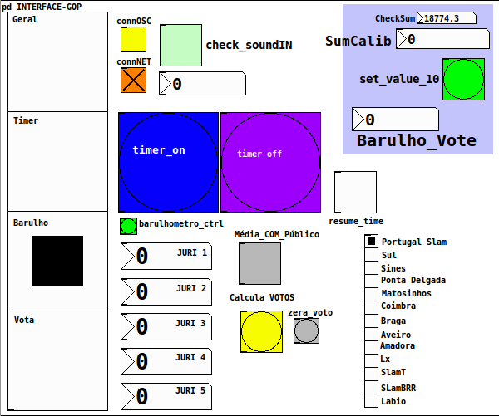
Choose type of connection
Check noise sum
Control timer
Set noise sum...
Choose mode:
1 Geral
MC and blabla
2 Timer
The poem starts
3 Barulho
Attention!
End of the poem
4 Vota
Juri votes and
calculation
...and assign
as value 10
Set Juri votes...
...and calculate
average

Slide 3
